Slide 1
CSC 280 Introduction to Computer Science: Programming with Python Lecture 1 : Course Overview
Prof. Bei Xiao
Fall, 2015
American University

Slide 2
First week’s task
Finish the course survey
Start to finish the to-do list on First Steps (will be handed out to you and also uploaded onto blackboard)
Set up Python

Slide 3
About Your Professor
Prof. Bei Xiao (vision scientist):
B.S. Tsinghua University, PhD University of Pennsylvania, Postdoc MIT.
https://sites.google.com/site/beixiao/
Research area: Human and Computer Vision. Computer Graphics.
Specialty: Material Perception, Multisensory perception, Physical-realistic rendering.
Preferred language: Python, MATLAB.
I teach: Intro to programming (CSC 280 this semester), Intro to Computer Vision (CSC579, Every other year), Web Programming (Spring, 2016), Computer graphics (near future) , Computational Neuroscience ( planned).

Slide 4
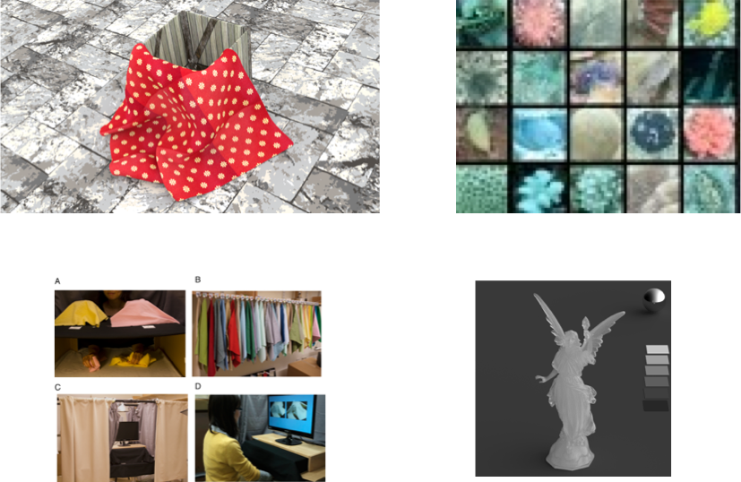
Project Gallery
Simulation of dynamic scenes
Under water color images
Visual and tactile material categorization
Understanding translucency

Slide 5
Logistics
Lectures: Mon, Thu, 2:35pm-3:50pm
Lab session: Wed 2:35pm-3:50pm. Individual or pair programming exercises. Sometimes the exercises will be requested to turned in!
Office hour:
Prof Xiao: SCAN 110 Monday 4-5:30pm, Thursday 4-5:30pm or by appointment.

Slide 6
Logistics
Blackboard: Homework posting & submission, announcements, lecture notes, discussions, grading.
Course webpage: course info, organization, reading assignments, lecture notes.
http://nw08.american.edu/~bxiao/CSC280_15/CSC280_Fall2015.html
Piazza for online discussions: Sign up here:
https://piazza.com/configure-classes/fall2015/csc280001

Slide 7
Textbooks
Textbooks:
How to think like a computer scientist: learning Python, Allen Downey (required) Online version available
Introduction to Computation and Programming Using Python, MIT Press, John Guttag. (recommended)
Tutorial:
Official Python Tutorial, by Guido van Rossum
Most learning materials are hand-outs

Slide 8
Class Structure
Lectures. Every Monday and Thursday (sometimes Wed as well). Not just slides. Integrative Demos almost every lecture.
Slides and codes posted after class.
Class roaster will be called every class.
Quiz is often conducted in class and will be graded.
Lab (Every Wed), guided program exercises and students will be asked to write solutions on white board. Solutions will be discussed in class.
Missing three classes will result in 0% attendance.

Slide 9
Course Objectives
Main goal: acquire the skill to make the computer do what you want them to do.
Write short and medium sized programs for a variety of applications.
Mostly importantly: how to map a problem to a computational framework
Prepare students for advanced courses in computer science, math, physics, and other technical courses.
Having a lot of fun!

Slide 10
Learning Outcomes
Fluency in (Python) procedural programming
Usage of assignments, conditionals and loops
Being familiar with data types
Ability to design Python modules and program
Knowledge of basic searching and sorting algorithms
Basic Competency in object-oriented programming

Slide 11
Course Outline (tentative)
Python Basics (Sep- Late October) Most Important!!!!
Syntax, Variables, Control Flow.
Basic Data Structure
Functions
Graphics, Mouse, Pygame
Text processing
Object-Oriented Programming (Late October – mid November)
Classes and objects
Inheritance
Selected topics (mid November to early December)
Simulation and random walk
Numerical Python
Recursion
Sorting, Searching, memorization

Slide 12
Grading
Grading: 60% Homework Assignments (6 projects), 15% in-class Mid-term exam (short programming exercises), 15% Final project, 5% in-class quizzes (randomly timed), 5% attendance.
Late Policy: all homeworks are due 11:59pm on the due date, homeworks submitted after the due date is NOT ACCEPTED.
All exams are open-book. But no internet allowed.

Slide 13
Communications
Piazza: Please sign up
Office hours: Monday (4-5pm), Thursday (4-6pm).
Email: bxiao@american.edu
But homework related questions MUST be asked before 48 hours of the deadline. Questions asked within the 48 hours are not promised to get answered.

Slide 14
What is computer science?
Problem-solving: puzzles, search, optimization, calculation beyond pencil and paper, storing information, retrieving information, tedious daily tasks one is too lazy to do, controlling robots….
Algorithm: a step by step list of instructions for solving ANY INSTANCE of the problem might rise.
Abstraction: separate logical and physical perspectives

Slide 15
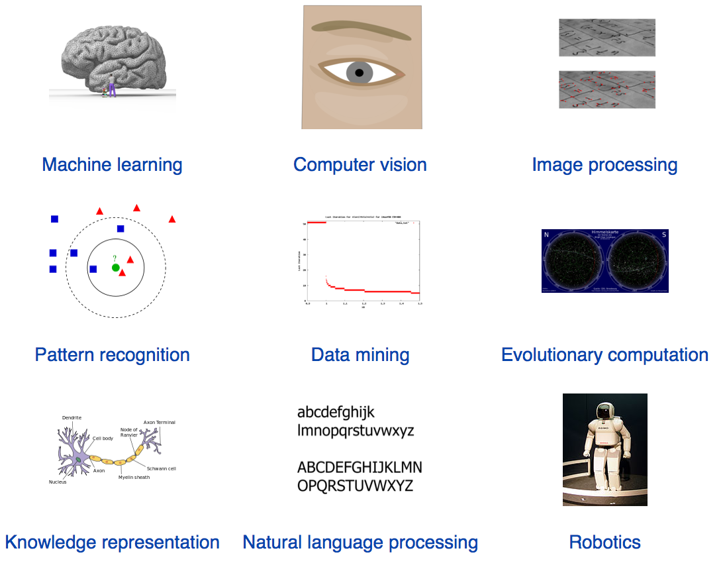
Computer Science Applications: AI

Slide 16
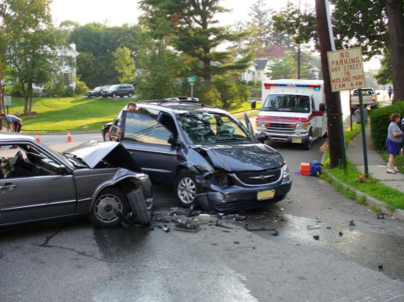
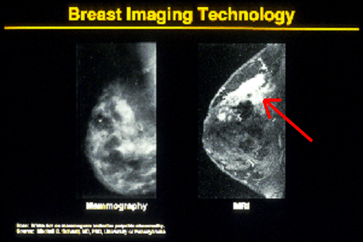
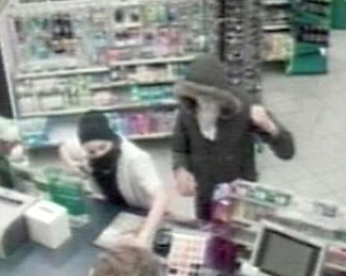
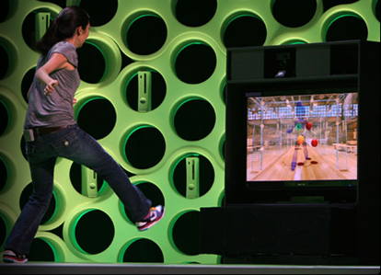
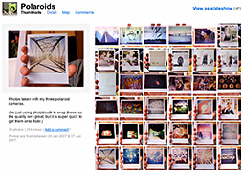
Computer Vision Applications
Safety
Health
Security
Comfort
Fun
Access
Slides from James Hayes

Slide 17
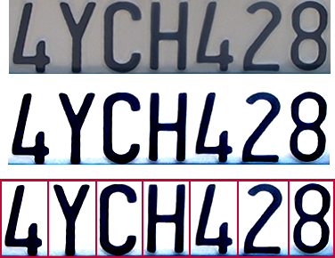
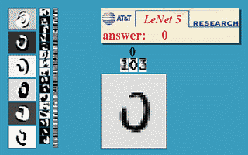
Optical character recognition (OCR)
Technology to convert scanned docs to text
If you have a scanner, it probably came with OCR software
Digit recognition, AT&T labs
http://www.research.att.com/~yann/
License plate readers
http://en.wikipedia.org/wiki/Automatic_number_plate_recognition
Slide from James Hayes

Slide 18
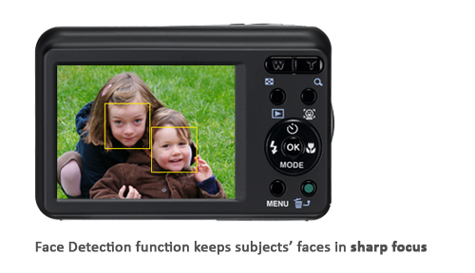
Face Detection

Slide 19
Gesture Recognition
http://www.webopedia.com/TERM/G/gesture_recognition.html
Notes:
Use gestures to control device Human computer interface

Slide 20
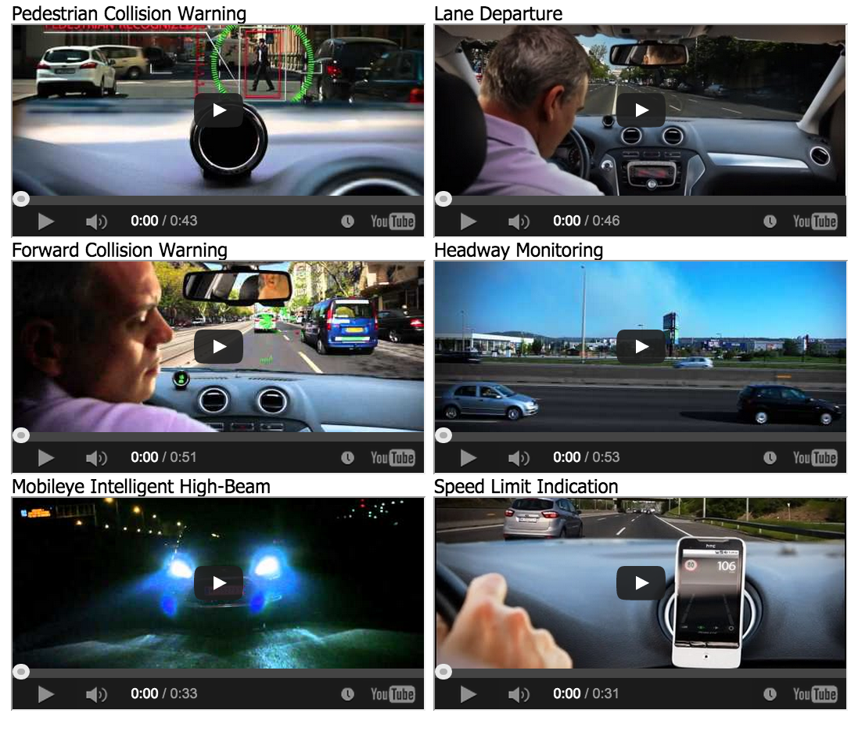
Mobile Eye for driving safety
http://www.mobileye.com/technology/

Slide 21
Computer Science Applications: Architecture and Engineering

Slide 22
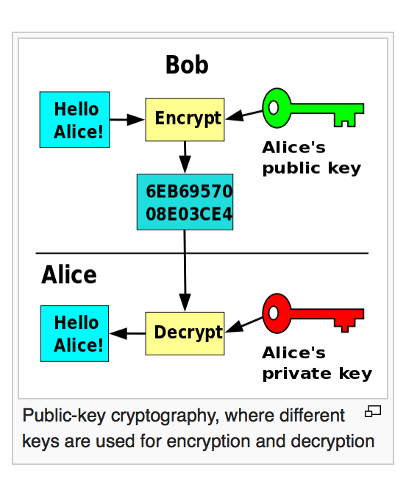
Computer Science Applications: Cybersecurity

Slide 23
Computer Science Applications: Computational Science

Slide 24
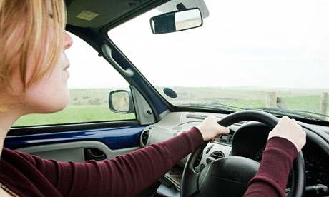
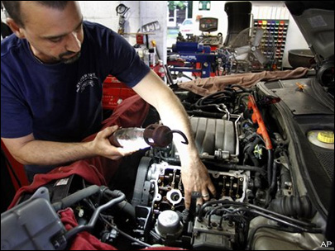
Logical vs. Physical Perspective
Driving the car
Logical perspective
of the automobile
also called “interface”
User operates
Repairing the car
Physical perspective
Control the
low-level details user
simply assumes

Slide 25
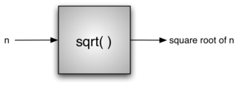
Procedural Abstraction
Compute square root:
In Python:
>>> import math
>>> math.sqrt(16)
4.0
>>>

Slide 26
What is computation?

Slide 27
Declarative Knowledge
Declarative knowledge is composed of statements of facts
“A good health care plan improves the quality of medical care while saving money”.
“DNA has double helix structure”.
“ y is square root of x if and only if y*y = x”
However, it doesn't’t tell you how to do this.

Slide 28
Imperative Knowledge
Imperative knowledge is about how to accomplish something. Think of it as a recipe.
How to compute square root:
1) start with a guess, g
2) if g * g is close enough to x, then g is a good approximation of the square root of x.
3) Otherwise, create a new guess by averaging g and x/g. I.e. g_new = (g_old + x/g_old)/2
4) Using the new guess, go back to step 2

Slide 29
Square Root
initial guess g = 3

Slide 30
Square Root
initial guess g = 3
3 * 3 = g square root of 25
g = (3+25/3)/2 = 5.66, very far off from 25

Slide 31
Square Root
initial guess g = 3
3 * 3 = g square root of 25
g = (3+25/3)/2 = 5.66
5.56 * 5.66 = 32.04, not quite 25
g = 5.04……. 25.4….close enough to 25, we are done.

Slide 32
Square Root
initial guess g = 3
3 * 3 = g square root of 25
g = (3+25/3)/2 = 5.66
Go back to Step 2, and repeat step 3, 5.56 * 5.66 = 32.04, not quite 25.
g = 5.04……. 25.4….close enough to 25, we are done.

Slide 33
Square Root Algorithm
Start with a guess, g
If g*g is close enough to x, then g is a good approximation of the square root of x
Otherwise, create a new guess, by averaging g and x/g
Use the new g to go back to Step 2. if it is not good enough, repeat…

Slide 34
What is algorithm
Algorithm- a description of how to perform a computation
The algorithm has converged.
How did we get here?
Set of instructions
A flow of control ( the order of executing)
Termination condition (when to stop)

Slide 35
Initial computer: fixed program computers
Designed to do very specific thing, such as square root.
First computer (1941) solve system of linear equations.
In WWII, Alan Turing create a computer to decipher German communications (see movie Inception, 2014)

Slide 36
Stored Program Computer
Treat data and instructions as the same thing
No distinction between the program (implement the algorithm) and the data the program operates.
Programs could produce programs.
Infinitely flexible.
Computer itself is a program. Interpreter.

Slide 37
Stored Program Computer
Treat data and instructions as the same thing
Memory
Control Unit
Algorithmic Logic Unit
Input /Output
Notes:
Control unit: send something to Memory.
Algorithmic Logic Unit: Brain of the computer
One kind of memory

Slide 38
What is programming language?
Combining small number of instructions (a dozen), you can create complex tasks
Alan Turing shows that there are 6 primitive instructions (read, write, plus, etc), each operates on 1 bit information and with this you can do anything with a computer.
A programming language provides a set of primitive instructions and a set of primitive control structures.

Slide 39
Alan Turing’s insight
There are only five actions that a computer has to perform in order to do "anything"
Every algorithm can be expressed in a language for a computer consisting of only five basic instructions:
move left one location
move right one location
read symbol at current location
print 0 at current location
print 1 at current location

Slide 40
What is different between programming languages?
Set of instructions
A flow of control ( the order of executing)
How to combine them?
It is the combining mechanism separate one programming from another.

Slide 41
Amazing thing about programming
Computer is always doing exactly WHATEVER you ask them to do.
Annoying: if your program doesn’t work, it is your own fault.

Slide 42
Syntax, Static Semantics, Semantics
Syntax: which sequences of characters and symbols constitute a well-formed string
e.g. x= 3+4 correct
x= 3 , 4 not correct
Static Semantics: which well-formed strings have a meaning.
3/“abc” syntactically fine, but not meaningful.
value operator value. but no real meaning.
Semantics: what that meaning is.
Both syntactically correct and static semantically correct

Slide 43
What might happen if the program doesn’t do what we want it to do?
It might crash. Stop running.
Never stopping. Infinite loop.
Run to completion but produce wrong answer
We will learn how to avoid this from happening
Programs that has very rigorous static semantics. E.g. Python doesn’t allow you do 3/’abc’

Slide 44
Some programming provides strict static semantics
Filtering out mistakes for you.
e.g. Python doesn’t allow you to do 3/”abc”
Java is very good at this.
But Python is better than C.

Slide 45
Why Python
Python is easy for beginners
Little to learn before you start doing
Designed with “rapid prototyping” in mind
Easy to learn other languages
Python is easier to debug
Python is a interpreting language
Python is highly relevant to non-CS majors
Python is the most wide used language in sciences
Python is a modern language
Popular for web applications
Also applicable to mobile app development

Slide 46
Next lecture
Types and Expressions
Lab: Getting started with Python
Take home: Finish First Steps Hand outs.
Notice the Class uses Python 2.7

Slide 47
Take-home work
Course Syllabus
Finish 1-3 in First-steps hand out
Read about Alan Turing and Turing machine:
https://en.wikipedia.org/wiki/Turing_machine

