Slide 1
CSC 280 Introduction to Computer Science: Programming with Python Lecture 3 : Variables and Assignment September 3, 2015
Prof. Bei Xiao
Fall, 2015
American University

Slide 2
Outline
Type review
Operator Precedence
Variable
Assignment
Dynamic Typing

Slide 3
Review of type conversion
What happens if you do
>>> 'ab' + 3
How about:
>>> 'ab' + str(3)
>>> int('3') + 3
What happes if you do this?
>>> int('0.0')
How about
>>> int(2.1)

Slide 4
Type: Set of values and the operation on them

Slide 5
Operator Precedence
What is the difference between the following?
2* (1+3)
2*1 +3
Operations are performed in a set order
Parentheses make the order explicit
What happens when there are no parentheses?
Operator Precedence:
The fixed order of Python process operators in absence of parentheses?
http://www.tutorialspoint.com/python/python_basic_operators.htm

Slide 6
Operator Precedence
Precedence goes downwards
Parentheses highest
Logical ops lowest
Same line = Same Precedence
Read “ties” from left to right for all but (**)
Example: 1 /2 * 3 = (1/2) *3
Exponentiation: **
Unary Operators: + - (e.g. 3- -2)
Binary arithmetic: * / %
Binary arithmetic: + -
Comparison: <> <= >=
Equality relations: == !=
Logical not
Logical and
Logical or
See Section 2.7 in your textbook
Will do more in Lab next week

Slide 7
Using IDEL editor to create a file
Program = Script = Code
Execute from the script
A script is a sequence of commands
Each one tells the interpreter to do something
>>> print type(3)

Slide 8
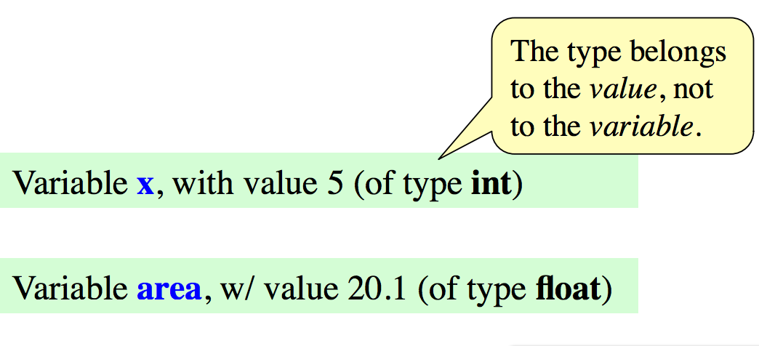
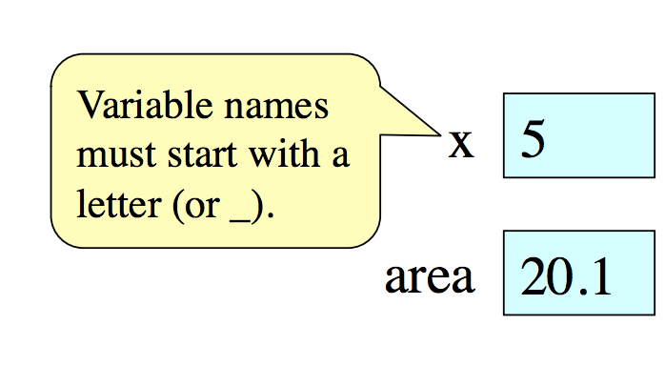
Variables
A Variable
Is a named memory location (box)
Contains a ( in the box)
Can be used in expressions
Examples:

Slide 9
Variables and Assignment Statements
Variables are created by assignment statements
Create a new variable name and give it a value
x = 5
This is a statement, not an expression
Tells the computer to DO something.
Type into >>> get no response, but it is working
Assignment statements can have expressions in them.
These expressions can even have variables in them.
the value
the variable

Slide 10
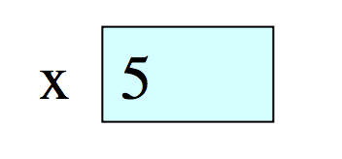
Execute the statement: x = x+2
Draw variable x on piece of paper, x = 5. Use a box to represent the variable.

Slide 11
Execute the statement: x = x+2
Draw variable x on piece of paper, x = 5. Use a box to represent the variable.
Step 1: evaluate the expression x+2
For x, use the value in variable x
Write the expression somewhere on your paper
Step 2: Store the value of the expression on x.
Cross off the old value in the box
Write the new value in the box
Check to see whether you did the same thing as your neighbor.

Slide 12
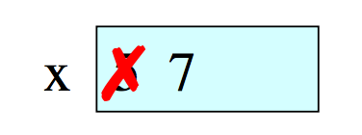
Execute the statement: x = x+2
Draw variable x on piece of paper
Step 1: evaluate the expression x+2
For x, use the value in variable x
Write the expression somewhere on your paper
Step 2: Store the value of the expression on x.
Cross off the old value in the box
Write the new value in the box
Check to see whether you did the same thing as your neighbor.

Slide 13
Execute the statement: x = 3*x +1
You have this:
Execute this command:
Step 1: Evaluate the expression
Step 2: Store its value in x
Check to see whether you did the same thing as your neighbor, discuss it if you did something else.

Slide 14
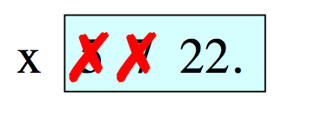
Execute the statement: x = 3.*x +1
You have this:
Execute this command:
Step 1: Evaluate the expression
Step 2: Store its value in x
Check to see whether you did the same thing as your neighbor, discuss it if you did something else.

Slide 15
Exercise: Understanding Assignment
Add another variable, interestRate, to get this:
Execute this assignment:
interstRate = 4
interestRate = x/intrestRate
Can you draw the box for interestRate? What do you get?

Slide 16
Exercise: Understanding Assignment
Add another variable, interestRate, to get this:
Execute this assignment:
interstRate = 4
interestRate = x/intrestRate
Can you draw the box for interestRate? What do you get?

Slide 17
Exercise: Understanding Assignment
Add another variable, interestRate, to get this:
Execute this assignment:
interstRate = 4
interestRate = x/intrestRate
Can you draw the box for interestRate? What do you get?

Slide 18
Exercise: Understanding Assignment
You now have this
Execute this assignment:
intrestRate = x+interestRate
Can you draw the box for interestRate? What do you get?

Slide 19
Exercise: Understanding Assignment
You now have this
Execute this assignment:
intrestRate = x+interestRate
Can you draw the box for interestRate? What do you get?

Slide 20
A pause
Do the following statement:
X = 5
X +1
print X
print X+1
What is the result?

Slide 21
Variables
Variable is a way to name an object
Assignment is to bind a name to an object
Assignment statement
height = 5
weight = 3
print height* weight

Slide 22
Variables can be string
Assignment statement
myString = “bei”
myString = myString + “xiao”
print myString
>>> myString = 'bei';
>>> myString
'bei'
>>> myString = myString + 'xiao'
>>> mySTring

Slide 23
Dynamic Typing
Python is a dynamically typed language
Variables can hold values of any type
Variables can hold different types at different times.
Use types(x) to find out the type of the value in x.
Use names of types for comparison and conversion.
The following is acceptable in Python:
>>> x=1 x contains an int value
>>> x = x/2.0 x now contains a float value.
Alternative, is a statically typed language (e.g. Java)
Each variable restricted to values of just one type

Slide 24
raw_input()
raw_input expects integrator the user to type in a string.
>>> y = raw_input('enter a number ?')
enter a number ?35.7
What is the type of y?
Raw_input() is different from input(), you should AVOID using input()

Slide 25
Exercise 1: using Python to calculate
Suppose the cover price of a book is $24.95, but the bookstores get a 40% discount.
Shipping costs $3 for the first copy and 75 cent for additional copy.
Write a program to print the wholesale cost for 60 copies?

Slide 26
Exercise 2
Create a new file and name it as BMI.py
Using raw_input() to ask the user of their height and weight, save these values as variables, and compute the body BMI and print out the result.
Hint: BMI is a person’s weight in kilograms divided by the square of height in meters.
BMI = weight /(height**2) in meters/kg
BMI = weight /(height**2) * 703 in lbs/inches
1lbs = 0.45kg
1inch = 0.025 meters
Extra: how about when users actually enters in units of lbs and inches?

Slide 27
Exercise 3: print out basic info
Enter your first name: Chuck
Enter your last name: Norris
Enter your date of birth:
Month? March
Day? 10
Year? 1940
Chuck Norris was born on March 10, 1940.
Hint: how to print comma? print mo, day+ ’,’ year.

Slide 28
Take home reading
Read Chapter 2
Do the following exercise:
http://learnpythonthehardway.org/book/ex4.html
Read about Operators in Python:
http://www.tutorialspoint.com/python/python_basic_operators.htm

Slide 29
Next week
Monday, No class. Labor day.
Wed, First lab sessions.
Notice: missing two lab sessions will get you 0% in attendance.

