Slide 1
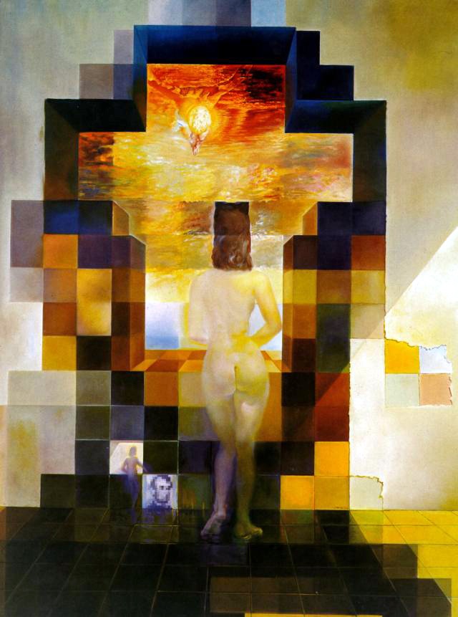
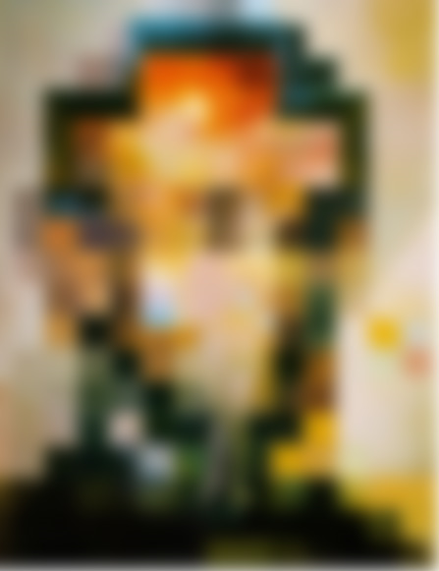
CSC 589 Introduction to Computer Vision
Lecture 2 linear filtering
Instructor: Bei Xiao
Thursday, January 15th
Salvador Dali
“Gala Contemplating the Mediterranean Sea,
which at 30 meters becomes the portrait
of Abraham Lincoln”, 1976

Slide 2
Take-home work (very important)
Reading
Read Szelisky : Chapter 3.1, 3.2. You can skip color if you want.
A tutorial on image convolution: http://lodev.org/cgtutor/filtering.html
Software
Install Numpy, Scipy
The easiest thing to do is to install Spyder, which has Numpy Scipy
https://bitbucket.org/spyder-ide/spyderlib/downloads
But if you can figure out using command line + sublime text, it will be great because eventually we will do that.
We will use Scipy.ndimages
http://docs.scipy.org/doc/scipy/reference/ndimage.html#scipy.ndimage
Scipy image tutorial: http://scipy-lectures.github.io/advanced/image_processing/

Slide 3
Today’s class
What is an image?
Point Process
Neighborhood operation
Convolution

Slide 4
Coding environment
MATLAB
  Pro: Well-established packages. Many tutorials and examples online. Great for numerical stuff.
  I have many years of experience with it.
Cons:
  Expensive! Talk to me about getting access.
  Not a general programming language.

Slide 5
Coding environment
Numerical Python
Pro: All the capabilities of MATLAB
  Free!
  Real programming Language
  Used for lots of stuff besides numerical programming
  By using it, we are contributing to the community of Python users!
Cons:
  Needs set up (install packages, import Libraries)
  documentation is a bit sparse, lack of good tutorials

Slide 6
Choices of Python Image libraries
Level 1 (basic): Numpy, treating image as matrix
Level 2 (Scipy): an image I/O (scipy.misc.imread), scipy.ndimage package that has convolution, filters, etc.
Level 3 (sckit-image): equivalent to MATLAB image processing toolbox, but better. Many built-in stuff, so not suitable for conceptual learning in the beginning.
High-level (OpenCV): it is not suitable for teaching but suitable for development. Very different from actual Python. We might use it for some projects later in the course.
Python Image Library (Pillow), kind of limited and not many people use it.

Slide 7
Choices of Python libraries
Level 1 (basic): Numpy, treating image as matrix
Level 2 (Scipy): an image I/O (scipy.misc.imread), scipy.ndimage package
Level 3 (sckit-image): equivalent to MATLAB image processing toolbox, but better. We will use it when we need to.
High-level (OpenCV): it is not suitable for teaching but suitable for development. We might use it for some projects later in the course.
The higher level library you use, the less control you have!

Slide 8
To start, we will use the basic level libraries!
Level 1 (basic): Numpy, basic numerical Python, treating image as matrix
Level 2 (Scipy): an image I/O (scipy.misc.imread), scipy.ndimage package
We will write our own functions!

Slide 9
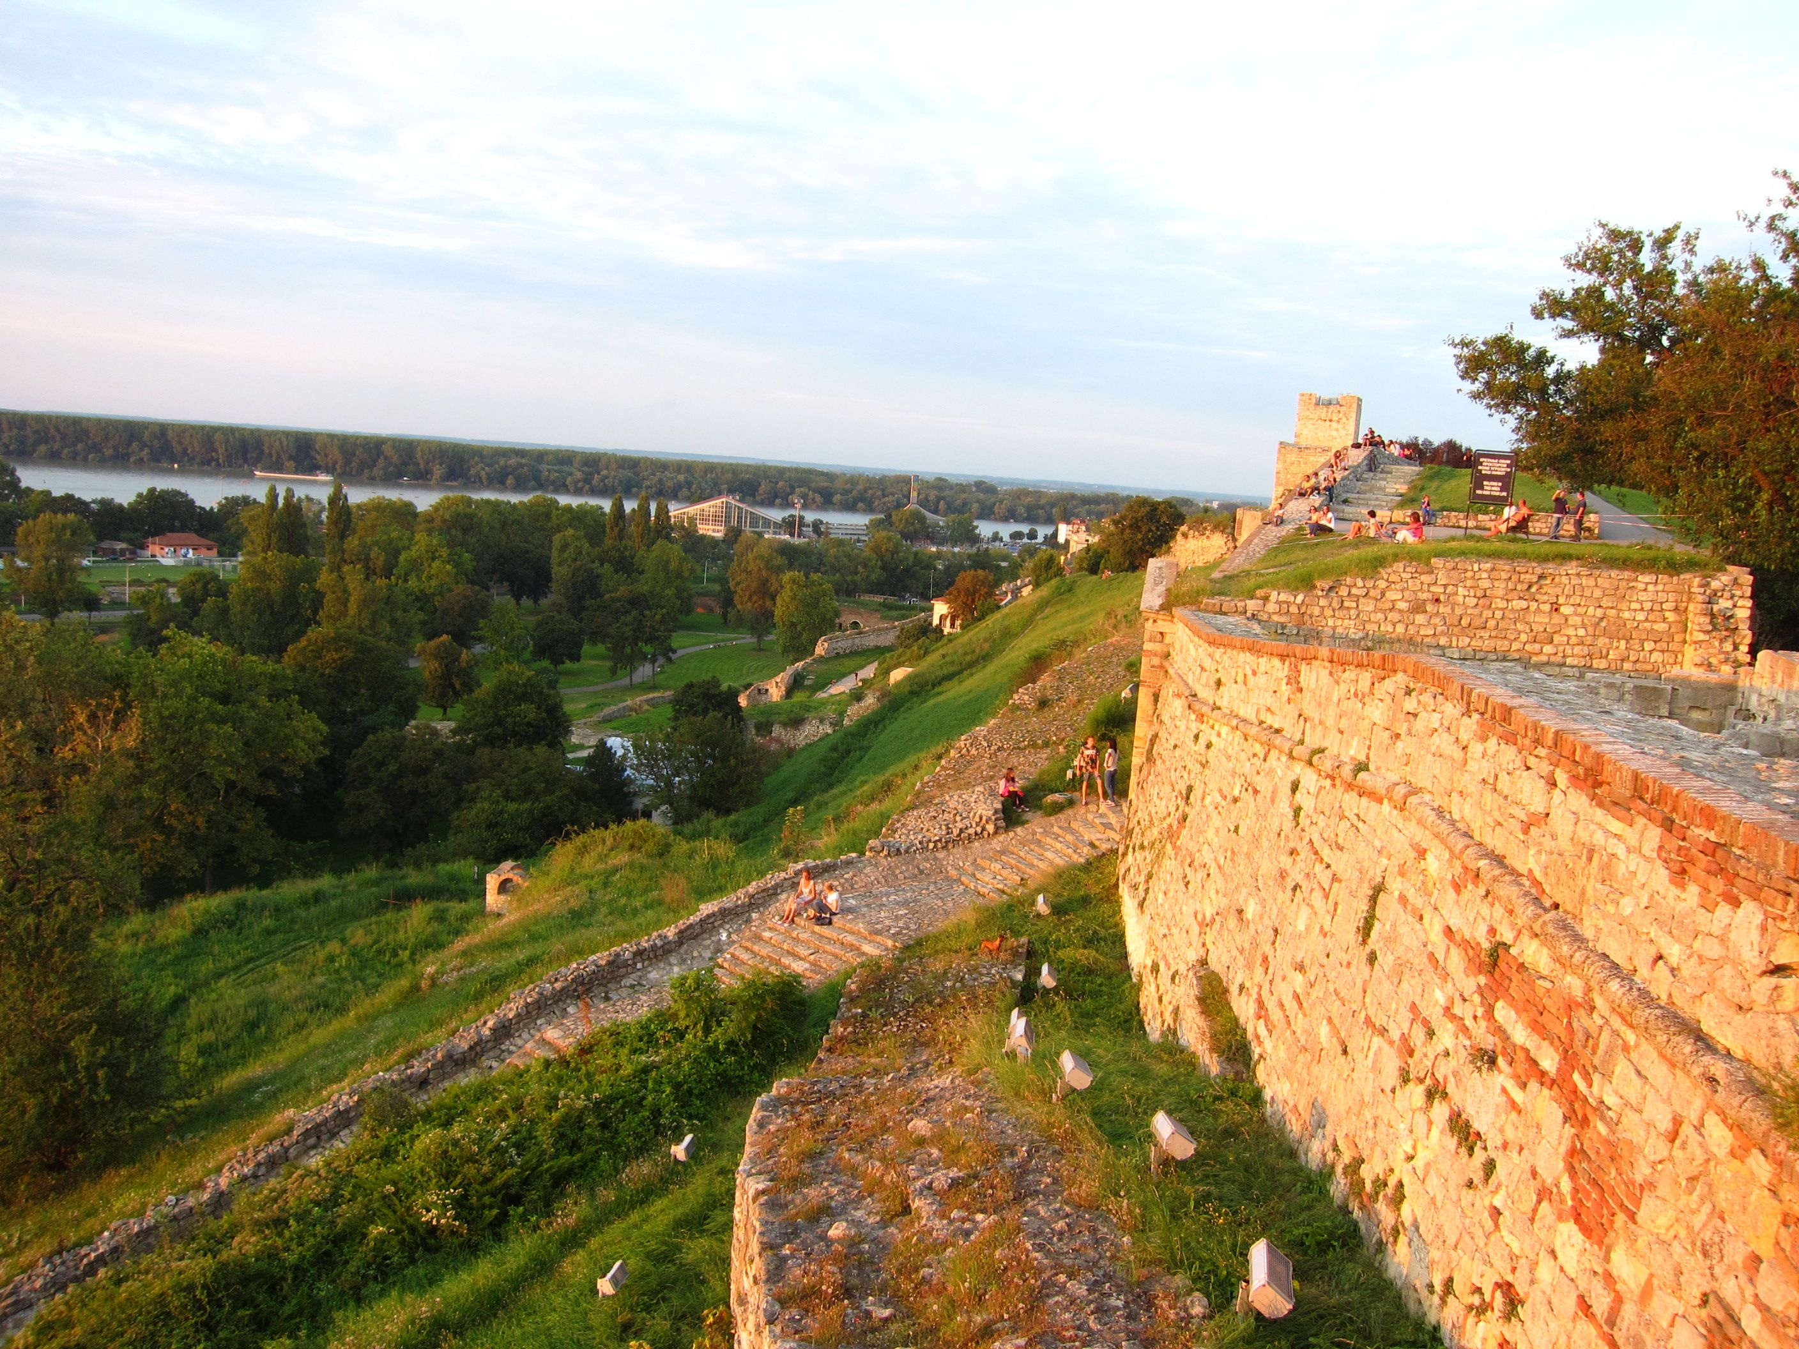
What is an image?

Slide 10
A useful tutorial
Computer vision for dummies

Slide 11


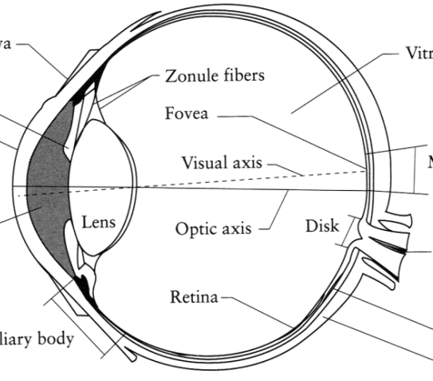
What is an image?
Digital Camera
We’ll focus on these in this class
(More on this process later)
The Eye
Source: A. Efros

Slide 12
What is an image?
A grid (matrix) of intensity values
(common to use one byte per value: 0 = black, 255 = white)
255 | 255 | 255 | 255 | 255 | 255 | 255 | 255 | 255 | 255 | 255 | 255
255 | 255 | 255 | 255 | 255 | 255 | 255 | 255 | 255 | 255 | 255 | 255
255 | 255 | 255 | 20 | 0 | 255 | 255 | 255 | 255 | 255 | 255 | 255
255 | 255 | 255 | 75 | 75 | 75 | 255 | 255 | 255 | 255 | 255 | 255
255 | 255 | 75 | 95 | 95 | 75 | 255 | 255 | 255 | 255 | 255 | 255
255 | 255 | 96 | 127 | 145 | 175 | 255 | 255 | 255 | 255 | 255 | 255
255 | 255 | 127 | 145 | 175 | 175 | 175 | 255 | 255 | 255 | 255 | 255
255 | 255 | 127 | 145 | 200 | 200 | 175 | 175 | 95 | 255 | 255 | 255
255 | 255 | 127 | 145 | 200 | 200 | 175 | 175 | 95 | 47 | 255 | 255
255 | 255 | 127 | 145 | 145 | 175 | 127 | 127 | 95 | 47 | 255 | 255
255 | 255 | 74 | 127 | 127 | 127 | 95 | 95 | 95 | 47 | 255 | 255
255 | 255 | 255 | 74 | 74 | 74 | 74 | 74 | 74 | 255 | 255 | 255
255 | 255 | 255 | 255 | 255 | 255 | 255 | 255 | 255 | 255 | 255 | 255
255 | 255 | 255 | 255 | 255 | 255 | 255 | 255 | 255 | 255 | 255 | 255
=

Slide 13
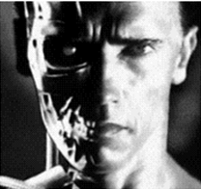
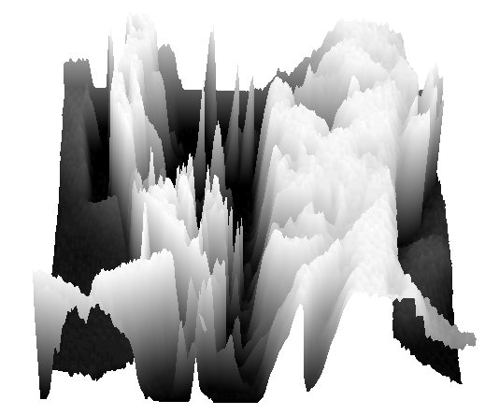
What is an image?
We can think of a (grayscale) image as a function, f, from R² to R:
  f (x,y) gives the intensity at position (x,y)
  A digital image is a discrete (sampled, quantized) version of this function
f (x, y)
x
y
Slide credit: James Hays

Slide 14

Image Processing
Define a new image g in terms of an existing image f
  We can transform either the domain or the range of f
Range transformation:
What kinds of operations can this perform?

Slide 15
Point Operations
Notes:
15

Slide 16
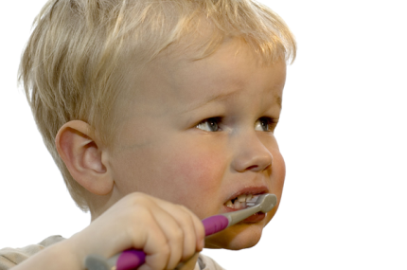
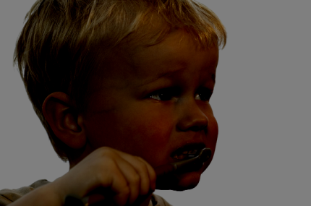
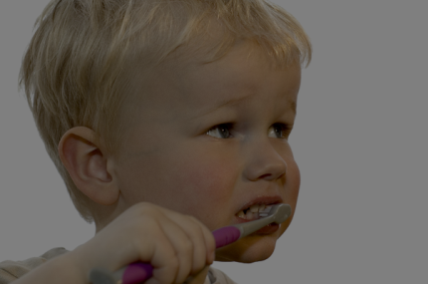
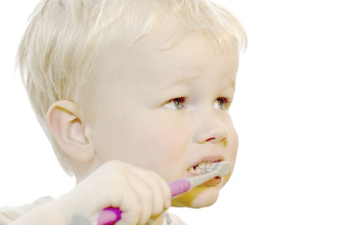
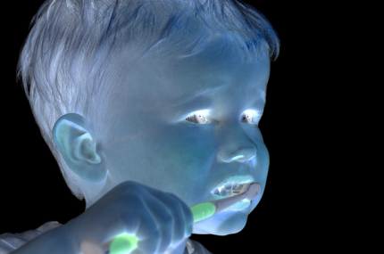


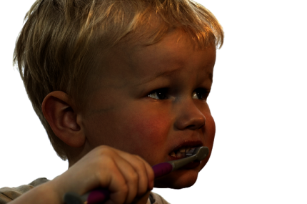
Point Processing
Nonlinear Lower Contrast
Original
Darken
Lower Contrast
Nonlinear Raise Contrast
Invert
Lighten
Raise Contrast
Slide source: S. Narasimhan
Notes:
16

Slide 17

Point Processing
Nonlinear Lower Contrast
Original
Darken
Lower Contrast
x
x - 128
x / 2
((x / 255.0) ^ 0.33) * 255.0
Nonlinear Raise Contrast
Invert
Lighten
Raise Contrast
255 - x
x + 128
x * 2
((x / 255.0) ^2) * 255.0
Slide source: S. Narasimhan
Notes:
17

Slide 18
Neighborhood Operations
Slide source: S. Narasimhan
Notes:
18

Slide 19
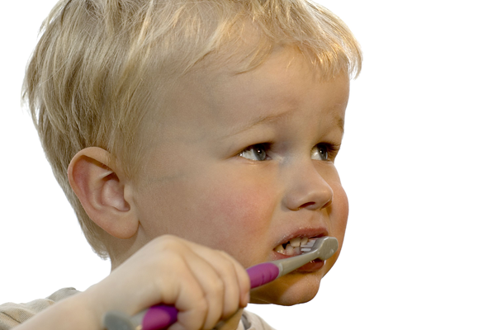
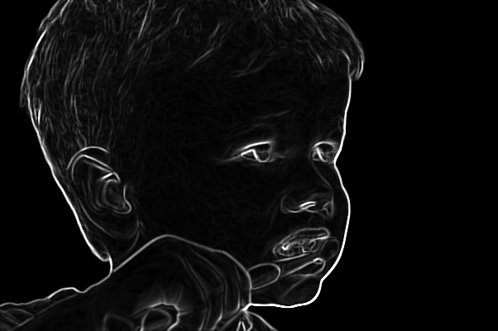
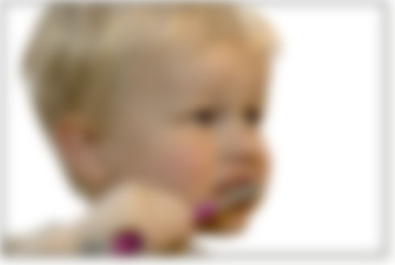
Neighborhood operations
Image
Edge detection
Blur
Slide source: S. Narasimhan
Notes:
19

Slide 20
Neighborhood operations
Image
Edge detection
Blur
Slide source: S. Narasimhan
Notes:
20

Slide 21
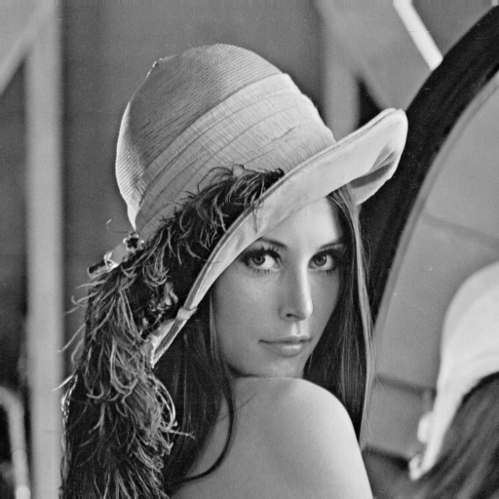

3×3 Neighborhood

Slide 22

5×5 Neighborhood

Slide 23

7×7 Neighborhood

Slide 24
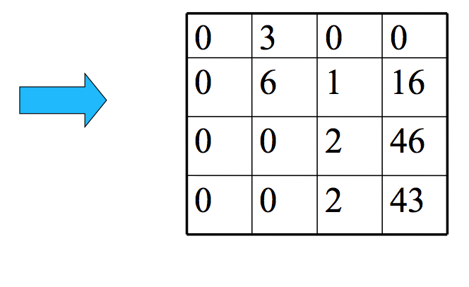
Let’s represent this more generally
Slide source: Matthew Tappen

Slide 25
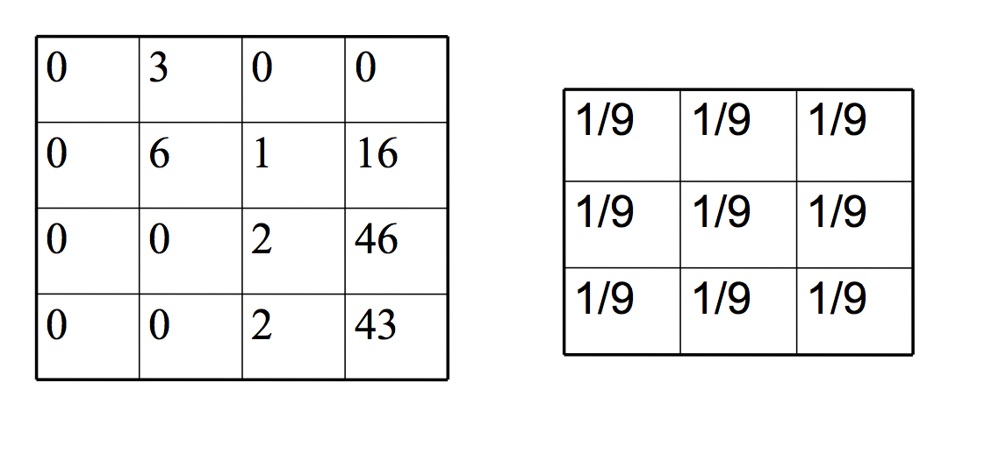
Let’s represent this more generally
Normalized box filter (3×3)
Slide source: Matthew Tappen

Slide 26
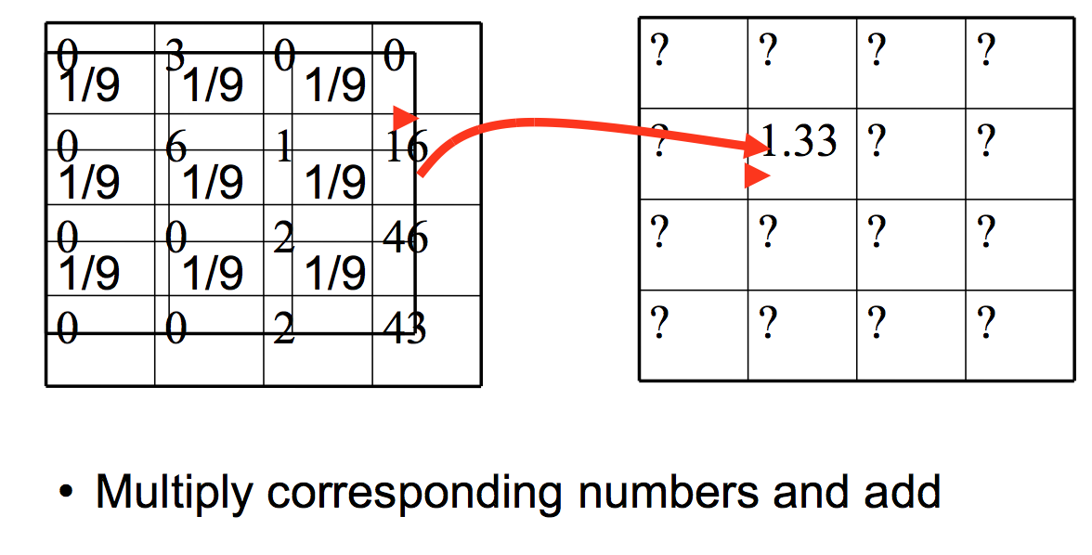
Let’s represent this more generally
Slide source: Matthew Tappen

Slide 27
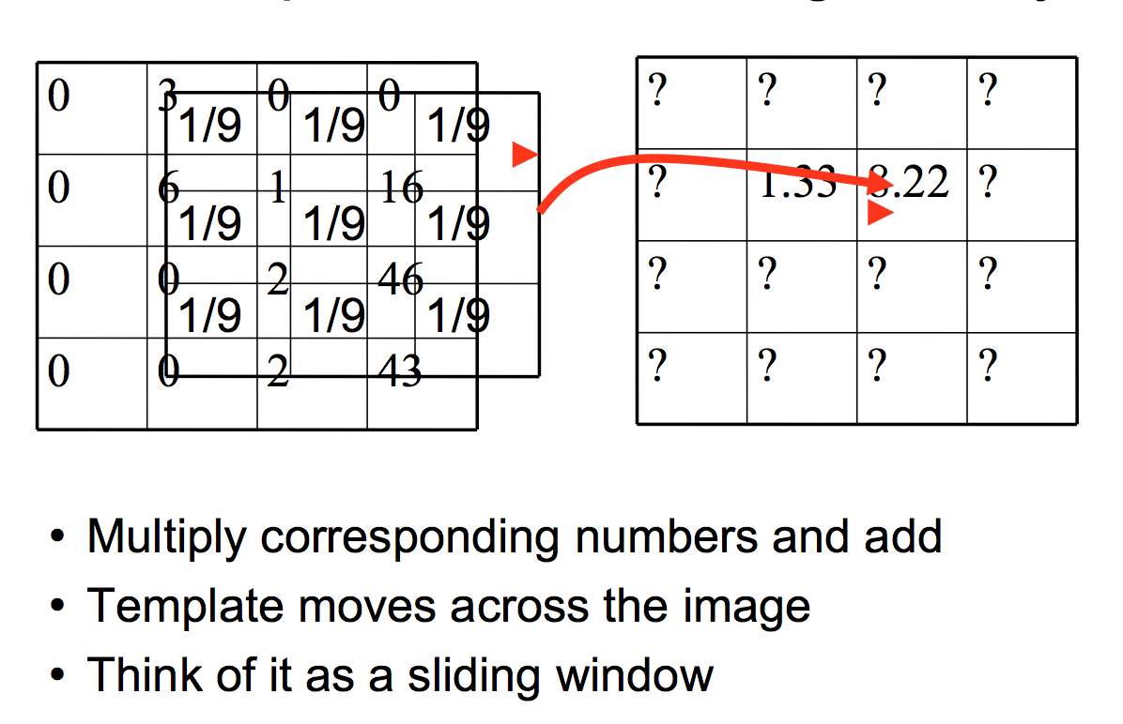
Let’s represent this more generally
Slide source: Matthew Tappen

Slide 28
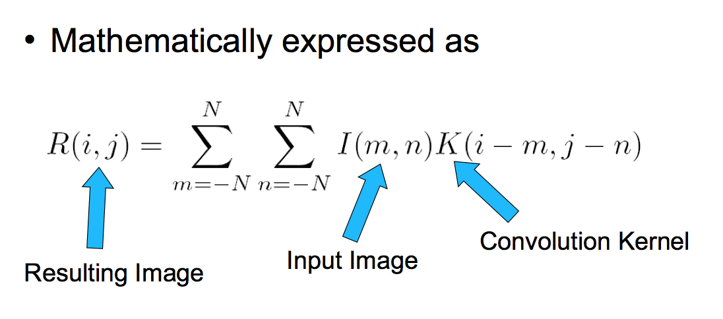
This is called convolution
Slide source: Matthew Tappen

Slide 29
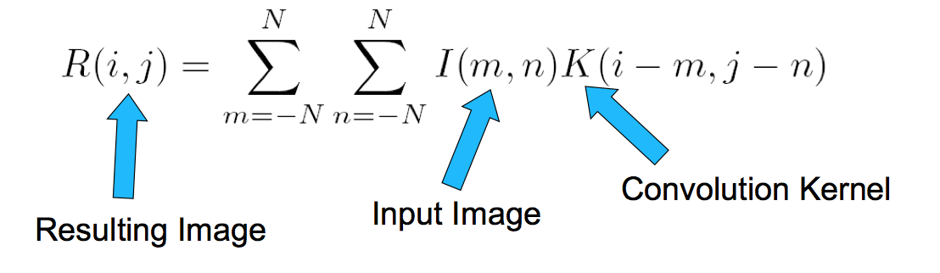
Notation
Also denoted as
R = I * K
We “convolve” I with K
-Not convolute!
Slide source: Matthew Tappen

Slide 30
Filtering vs. Convolution
2d filtering
  h=filter2(g,f); or h=imfilter(f,g);
2d convolution
  h=conv2(g,f);
We use Filter and Convolution interchangeable when the image is SYMMETRIC

Slide 31
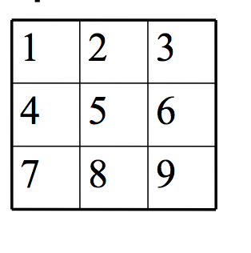
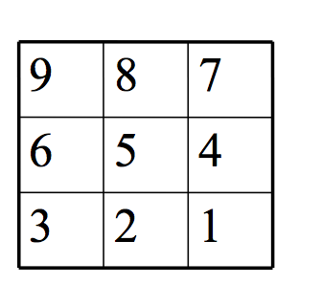
Sliding Template View
Take the template K
Flip it
Slide across image
Slide source: Matthew Tappen

Slide 32
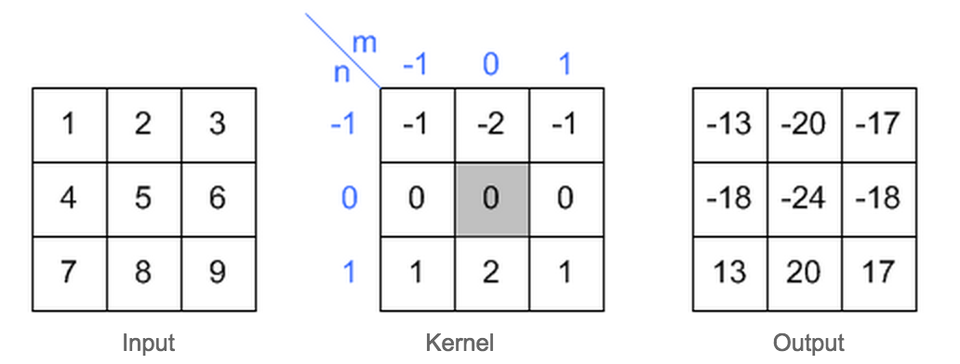
Let’s take out paper and pen
What is the result of the following convolution?

Slide 33
Let’s take out paper and pen
What is the result of the following convolution?

Slide 34
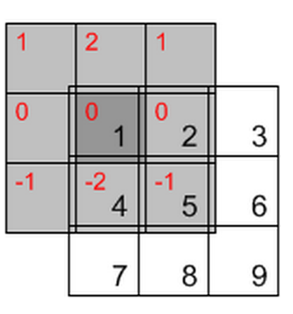
Let’s take out a paper and a pen
What is the result of the following convolution?
1*0 + 2*0 + 1*0+
0*0 + 1*0 + 2*0+
(-1)*0 + (-2)*4 +(-1)*5 = -13

Slide 35
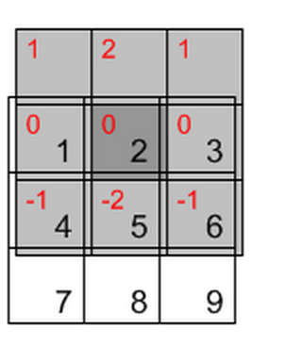
Let’s take out a paper and a pen
What is the result of the following convolution?

Slide 36
Rules of a image filter
It’s size has to be uneven, so that it has a center, for example, 3×3, 5×5, 7×7
It doesn’t have to, but the sum of all elements of the filter should be 1 if you want the result image to have the same brightness as the original
If the sum of the element of is larger than 1, the result will be a brighter image, if it is smaller than 1, the resulting image will be darker.

Slide 37
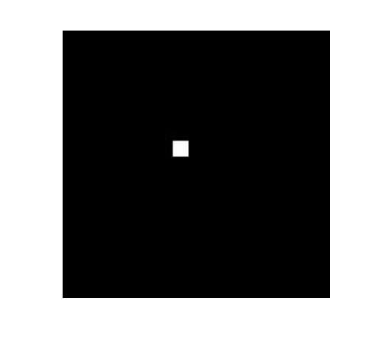
Predict the image
Slide source: Matthew Tappen

Slide 38
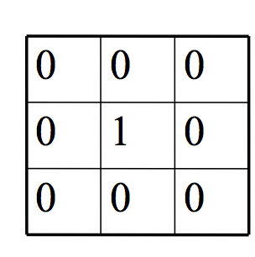
Predict the image
Slide source: Matthew Tappen

Slide 39
Predict the image
Slide source: Matthew Tappen

Slide 40
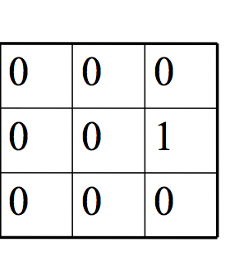
Predict the image
Slide source: Matthew Tappen

Slide 41

Predict the image
Slide source: Matthew Tappen

Slide 42
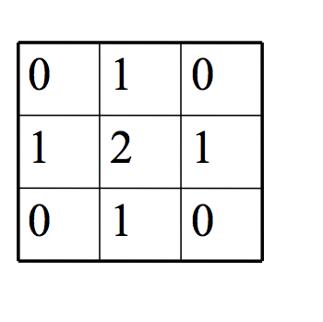
Predict the image
Slide source: Matthew Tappen

Slide 43
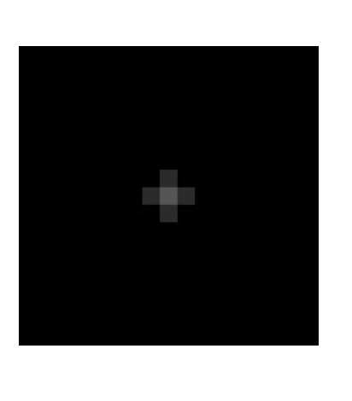
Predict the image
Should be brighter!
Slide source: Matthew Tappen

Slide 44

Practice with linear filters
*
0
0
0
=
0
1
0
0
0
0
Original
Filtered
(no change)
Source: D. Lowe

Slide 45
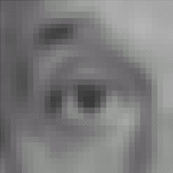

Linear filters: examples
*
1
1
1
=
1
1
1
1
1
1
Original
Blur (with a mean filter)
Source: D. Lowe

Slide 46
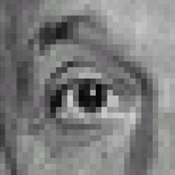

Practice with linear filters
0
0
0
-
1
1
1
0
2
0
1
1
1
0
0
0
1
1
1
Original
Sharpening filter
  Accentuates differences with local average
Source: D. Lowe

Slide 47

Sharpening
Source: D. Lowe

Slide 48


Other filters
1
0
-1
2
0
-2
1
0
-1
Sobel
Vertical Edge
(absolute value)

Slide 49

Other filters
1
2
1
0
0
0
-1
-2
-1
Sobel
Horizontal Edge
(absolute value)
Notes:
Questions at this point?

Slide 50
Next class (Next Thursday)
Tutorial on image processing with Python (Numpy, Scipy, Matplotlib)
More on image processing, contrast enhancement, image histograms, Gaussian Filter

